Slide 1

Big data analysis insights into transcriptomics analysis
Presented By:
Rajesh Kumar Gazara, Ph.D.
Senior Bioinformatics Analyst @xNARA Biologics

Slide 2
Aim of this session
In this session we will go through all of the steps of RNA-Seq analysis in order to identify differential expressed genes, which will include:
Reads Quality control
Filtering and trimming of reads
Create a genome index file
Mapping filtered reads to a reference genome
Mapping Stats
Read quantification
Differential expression analysis

Slide 3

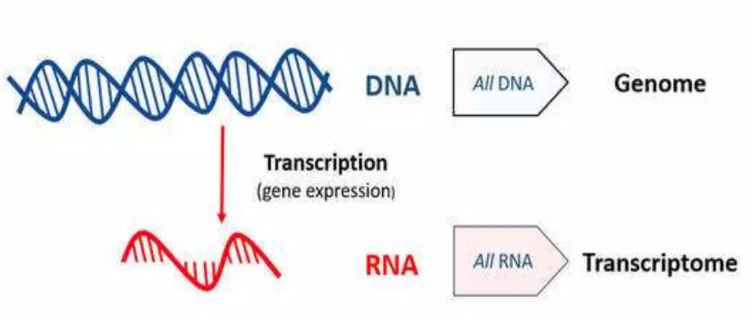
Transcriptome
A transcriptome is the set of all RNAs, including mRNAs, rRNAs, tRNAs and other non-coding RNAs in a cell.
Transcriptome studies are essential to understand expressed gene of any organism under a particular condition or developmental stage.

Slide 4
Transcriptome sequencing ands its application
It is the process of sequencing the transcriptome.
RNA sequencing method | Description and benefits
Total RNA Whole transcriptome | Whole transcriptome analysis to examine coding and noncoding RNA simultaneously; suitable for novel discovery.
mRNA sequencing | To sequence all messenger RNA for gene expression analysis; able to identify novel and known content
smRNA sequencing | Isolation of small RNA to focus study on noncoding RNA to identify novel and known content such as microRNA (miRNA)
Targeted RNA sequencing | Sequencing specific transcripts of interest to focus efforts and lower cost to analyze specific genes of interest.
Notes:
Various uses of RNA-Seq and technologies (illumina, EST-sanger, 454)

Slide 5
Sequencing Platforms
High throughput Sequencing technologies applicable to RNA-Seq
Short Read sequencing platforms
1. Illumina (NovaSeq, Hi-Seq, Mi-Seq and NextSeq) – Read length 50–300 base pairs (bp) long
2. Ion Torrent (Ion GeneStudio) : Read length: up to 600 bp
Long Read sequencing platforms
1. PacBio : Read length: 15–20 kb
2. Oxford Nanopore (MinION and GridIon) : Read length: 10-100 kb
Notes:
Various uses of RNA-Seq and technologies (illumina, EST-sanger, 454)

Slide 6
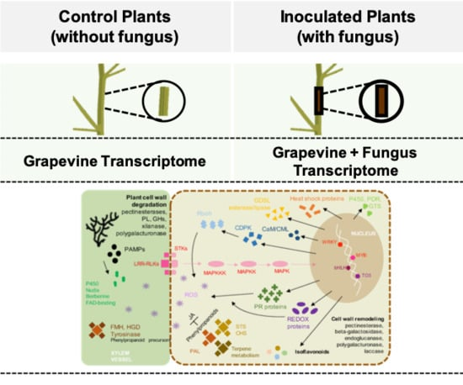
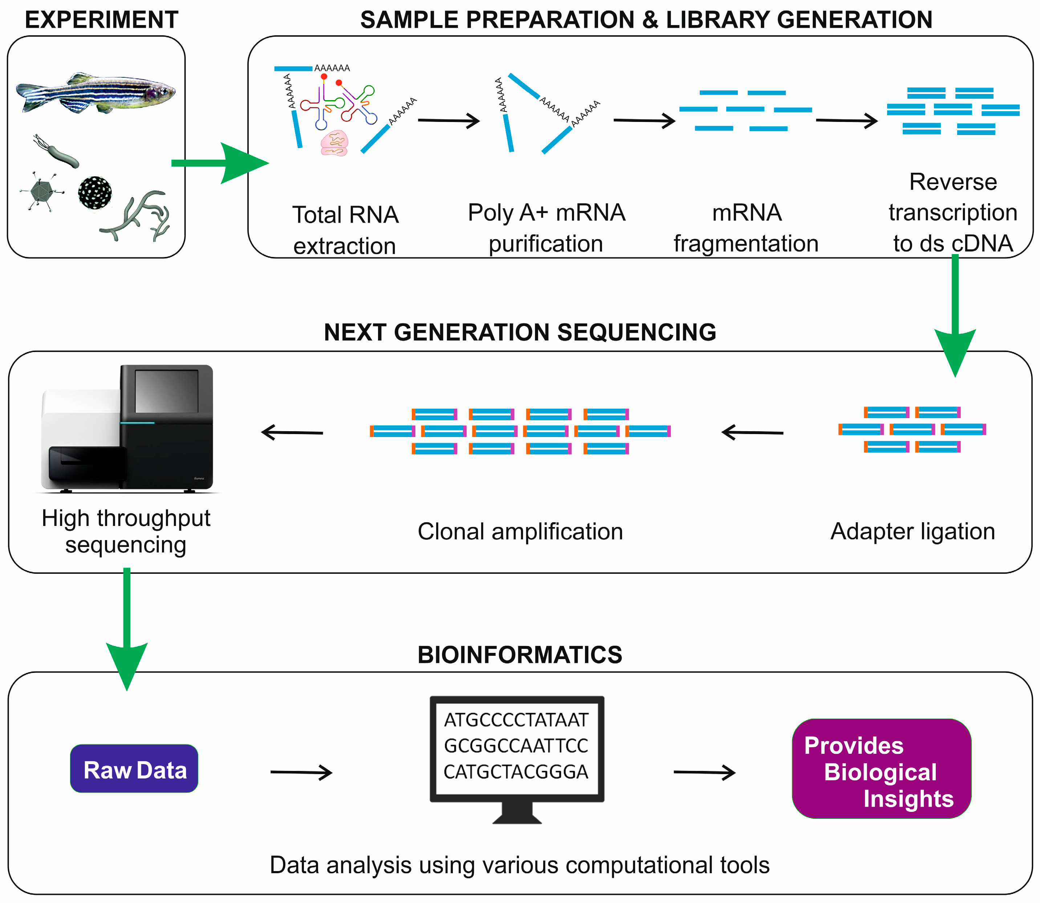
RNA Sequencing Steps
1. Experiment Design
2.
3.
https://biocorecrg.github.io/PHINDaccess_RNAseq_2020/library.html; https://www.mdpi.com/1422-0067/20/23/6083#

Slide 7
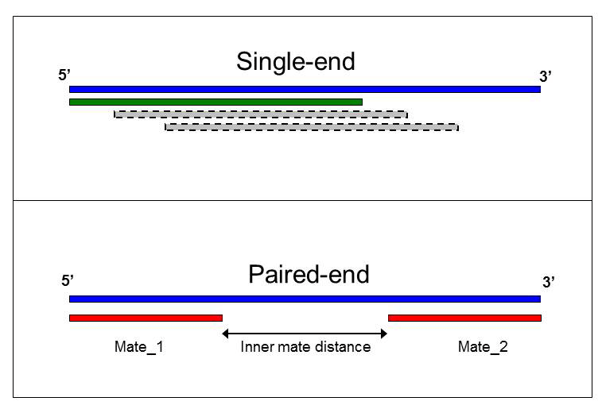
Single-end and Paired-end Sequencing
Single-end RNA sequencing reads a fragment from one end to the other.
Paired-end RNA sequencing reads both ends of the fragment.
Single-end or Paired end?
Depends on what your goals are.
For example:
i) For identification of novel transcripts, paired-end reads are preferred.
ii) For smRNA-seq, single-end reads can be a good choice.
Notes:
Various uses of RNA-Seq and technologies (illumina, EST-sanger, 454)

Slide 8
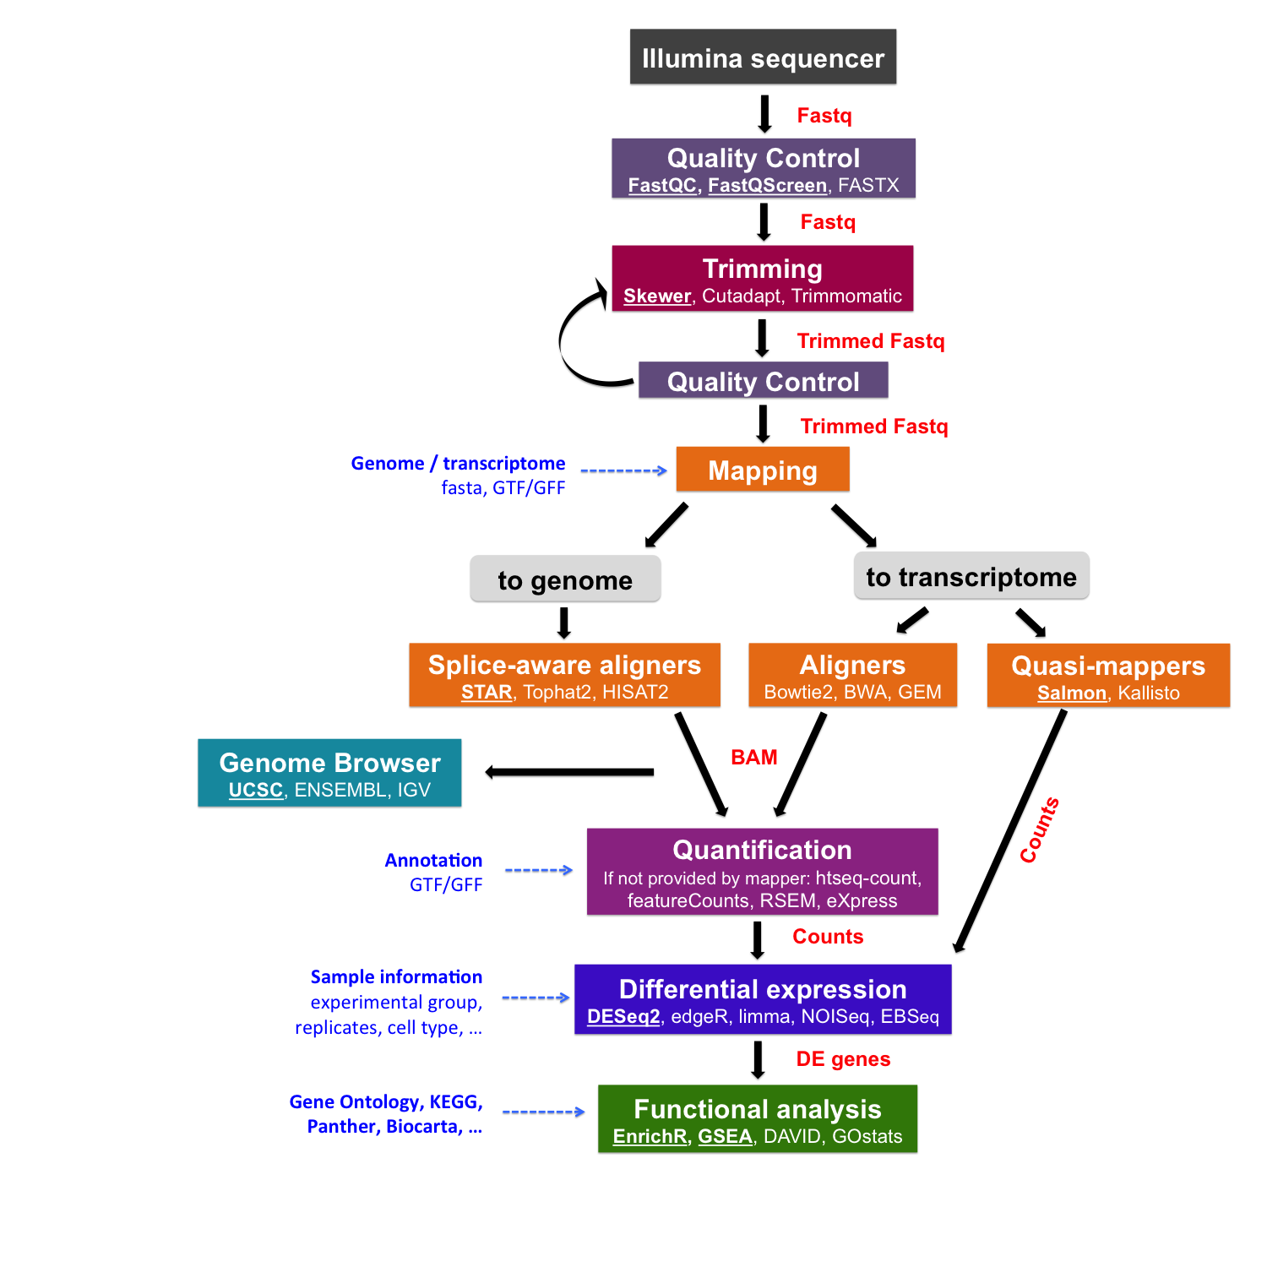
RNA-seq Bioinformatics Analysis
https://biocorecrg.github.io/PHINDaccess_RNAseq_2020/workflow.html

Slide 9
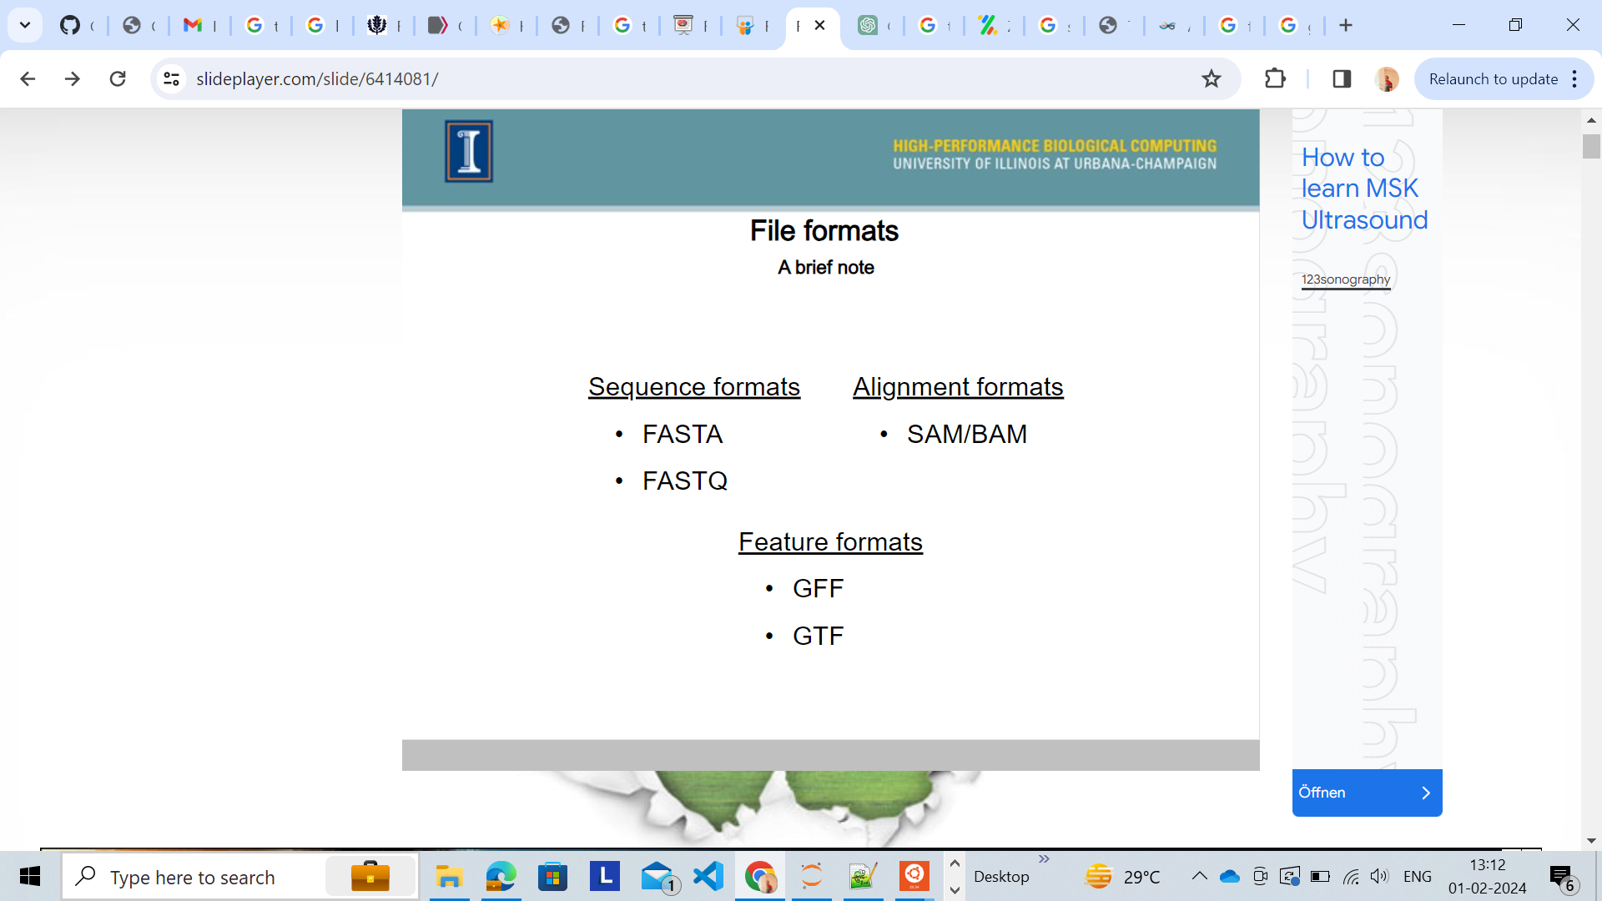

Slide 10
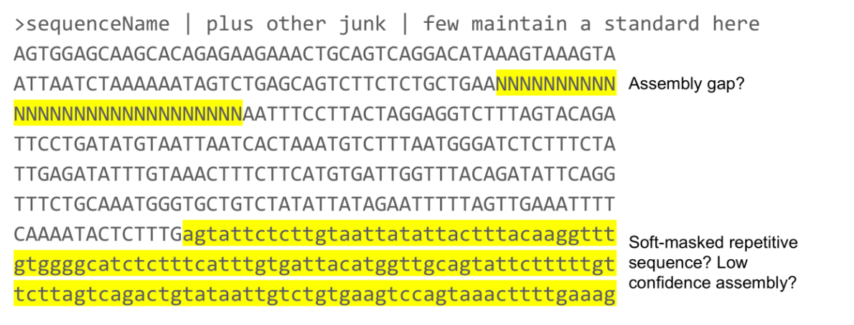
Fasta File Format

Slide 11
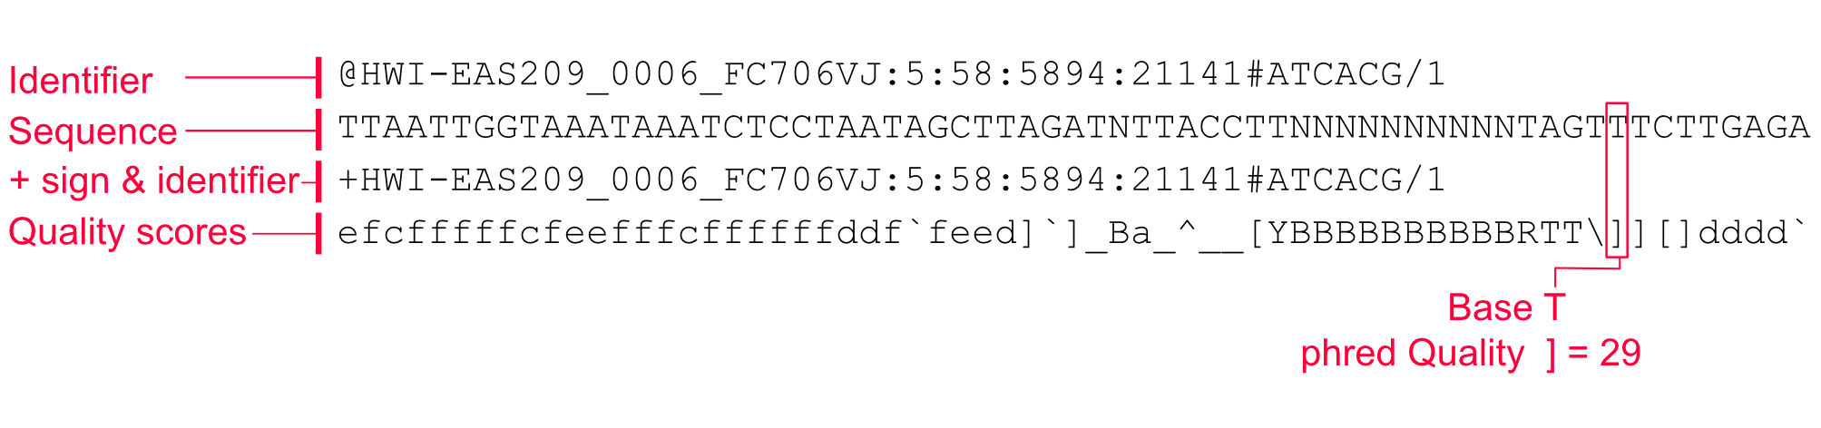
Fastq File Format
Insert size for paired-end data?
Usually for all RNA-Seq applications it is between 300 to 600 nucleotides, unless otherwise specified by a downstream application.

Slide 12
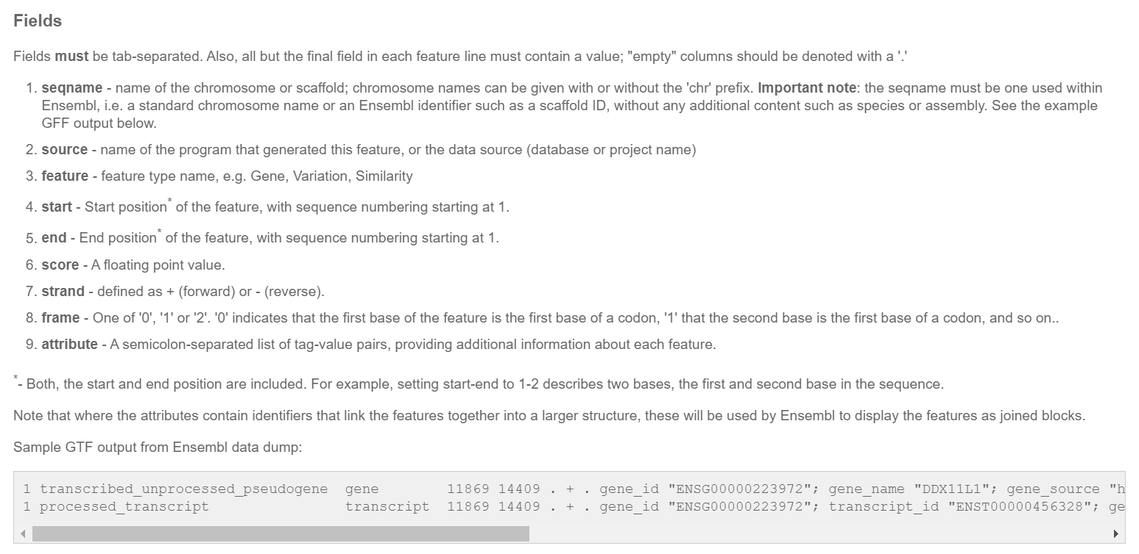
GTF/GFF

Slide 13
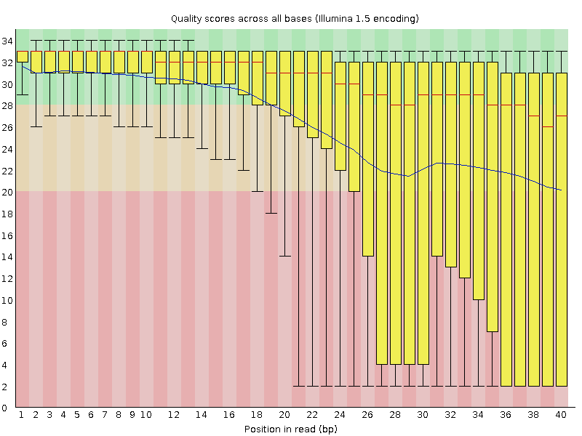
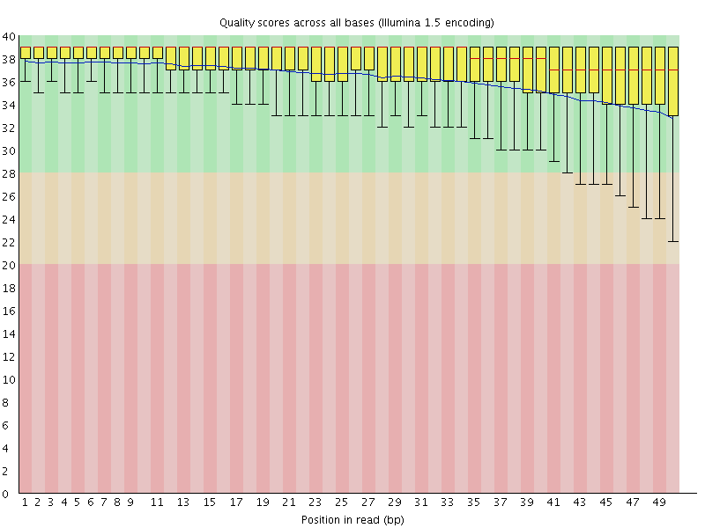
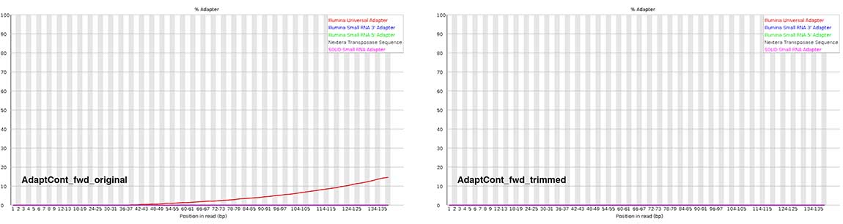
Quality Control
Poor quality!
Good quality!

Slide 14
Mapping RNA-seq reads on reference genome
We need to align the sequencing reads data to our genome of interest
If aligning RNA-Seq data to the genome, always pick a sPlice-aware aligner
Genome
Alignment
Reads
Bowtie2|BWA
Gene
Versus
Genome
Splice-Aware
Alignment
Reads
Tophat2|STAR|HISAT2
Gene

Slide 15
Software
The software which will be used in this session is listed below.
HiSat2 (https://ccb.jhu.edu/software/hisat2)
Samtools (http://www.htslib.org/)
FastQC (http://www.bioinformatics.babraham.ac.uk/projects/fastqc/)
Cutadapt (https://pypi.python.org/pypi/cutadapt)
Trim_Galore (http://www.bioinformatics.babraham.ac.uk/projects/trim_galore/)
featureCounts (https://subread.sourceforge.net/featureCounts.html)
R (http://www.r-project.org/)
DESeq2 – part of bioconductor (http://www.bioconductor.org/)

Slide 16
Data
The data in this practical comes from:
Yeast data for mapping comes from GEO accession SRR453566
Yeast genome data and GTF models come from Ensembl (http://www.ensembl.org/Saccharomyces_cerevisiae/)
Github:
https://github.com/rajeshgazara/RNA-seq_tutorial/

